Slide 1

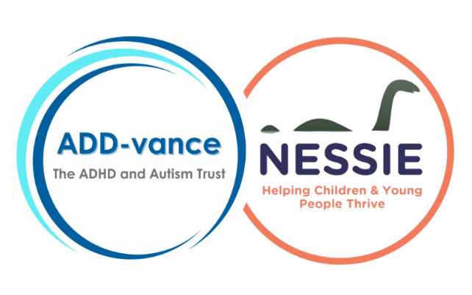


Understanding Autism and ADHD
“Different Belongs”

Slide 2
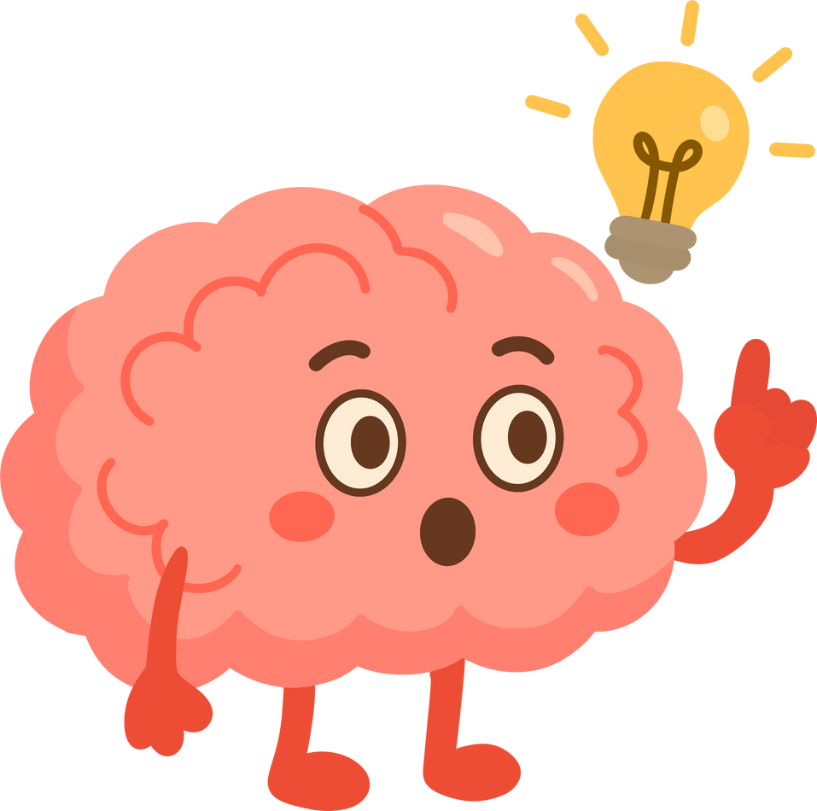
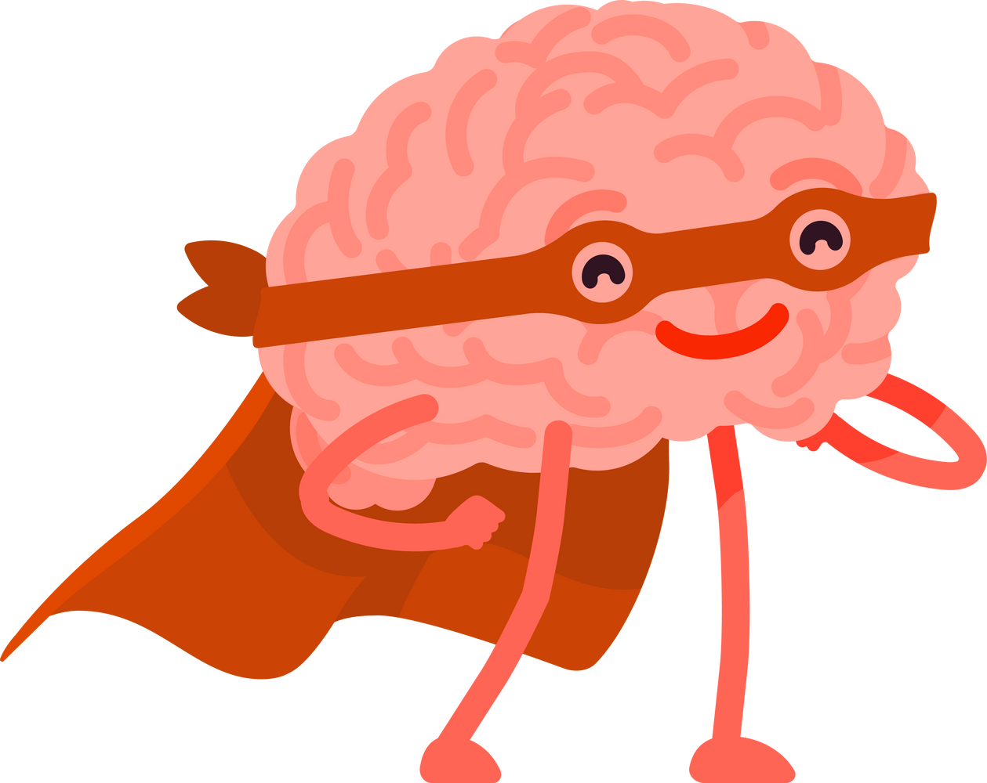

Different Brains
Autistic Brains
Text
ADHD Brains
Notes:
Good morning everyone.
Today we’re going to talk about ‘different’ brains and we’re going to be thinking about two kinds of brains you might have heard of:
Autistic brains and ADHD brains.
Some people in this room may be autistic. Some people may be ADHD. Some people may be both. Others in the room may be neither - we all have brains that work in different ways.

Slide 3
What does Autism Mean?
What does ADHD mean?
Notes:
What does autism mean?
Autism is a different way a brain works.
Autistic people may: notice details others don’t, think deeply about things they care about, prefer routines or predictability and find noise, lights, or busy places overwhelming.
Autism is not an illness and it is not something that needs fixing. It’s who someone is – their identity.
What does ADHD mean?
ADHD is also a different way a brain works.
People who are ADHD may: have lots of energy, think very quickly, find it hard to sit still or focus for long and have big ideas and strong creativity.
ADHD is not about being lazy or naughty - It is about how attention and energy work in the brain.

Slide 4
Quick Quiz
Notes:
There are a lot of Myths that people believe about Autism and ADHD, that are simply NOT TRUE!
Let’s test your knowledge and see what YOU know?
I’m going to give you a sentence about Autism or ADHD and you have to decide if it’s a truth or if it’s a myth.

Slide 5
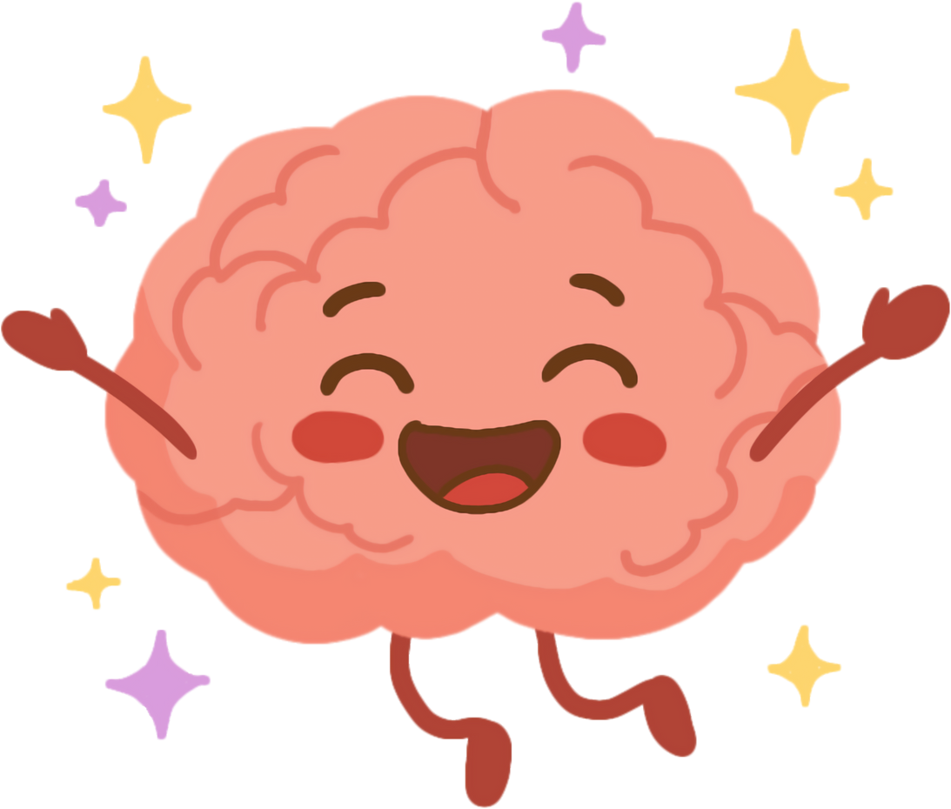

Autistic people don’t have feelings
MYTH
Autistic people have a wide range of feelings and emotions, just like
everyone else.
They just may express them differently.
Notes:
Take suggestions for each questions… hands up if you think truth? Hands up if you think myth?

Slide 6
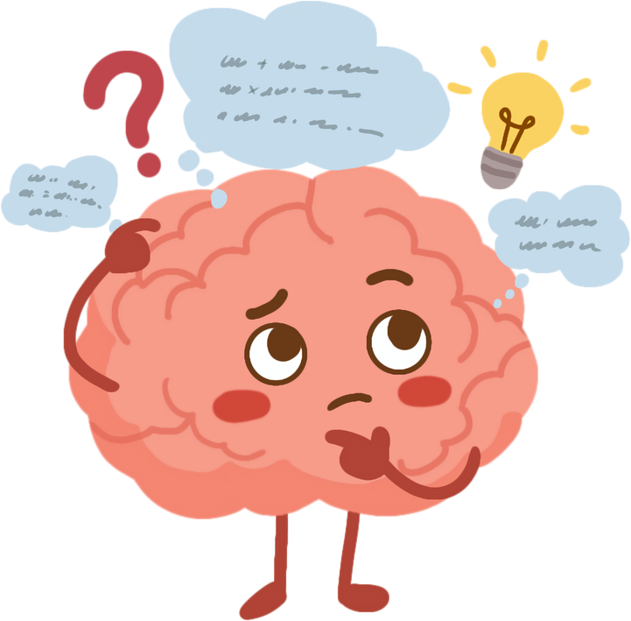
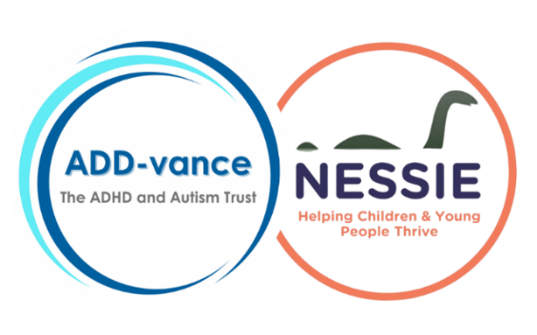
ADHD is a made-up condition where individuals choose how they behave
MYTH
ADHD is real. It determines how a
person thinks and behaves. They
can’t control this.

Slide 7
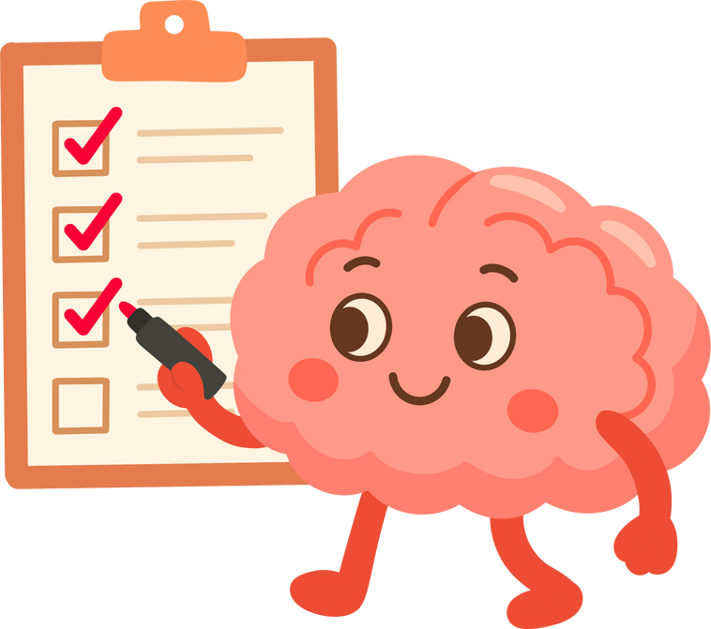

All Autistic people are the same
MYTH
Autism is like a constellation of stars.
Each person has their unique pattern of strengths and challenges.
Notes:
Take suggestions for each questions… hands up if you think truth? Hands up if you think myth?

Slide 8
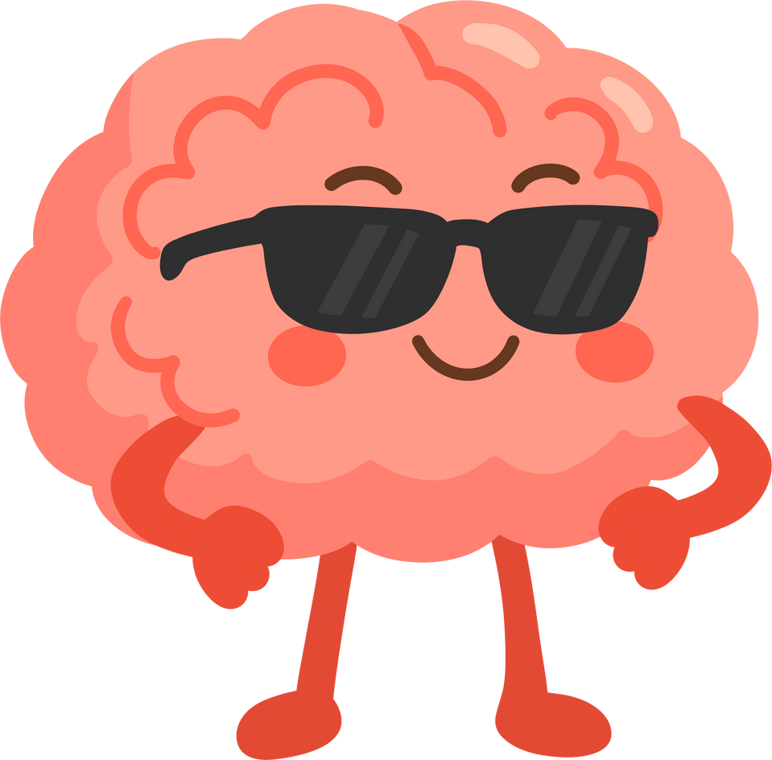

Only children can be ADHD
MYTH
Although ADHD is often diagnosed in childhood, it’s a person’s unique brain chemistry forever.

Slide 9
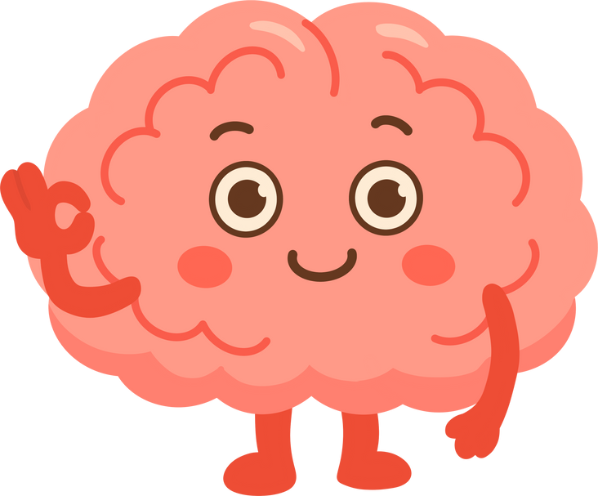
Autism is neurological – this means it is about how your brain works
TRUTH
Autism is influenced by genes and often runs in families.
Notes:
Take suggestions for each questions… hands up if you think truth? Hands up if you think myth?

Slide 10
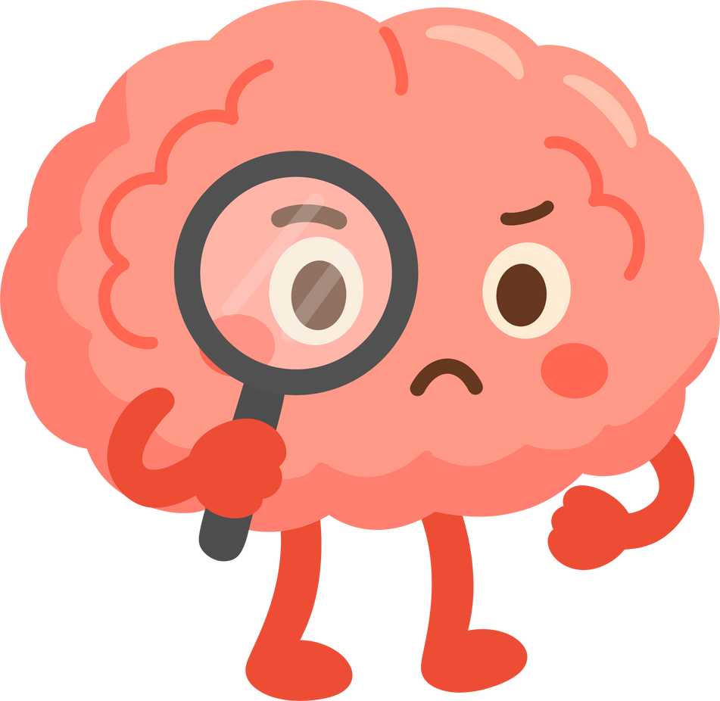
Children who are ADHD are lazy or not trying hard enough.
MYTH
Children who are ADHD often struggle with focus. This is not lazy or rude but rather a challenge in managing their attention.

Slide 11
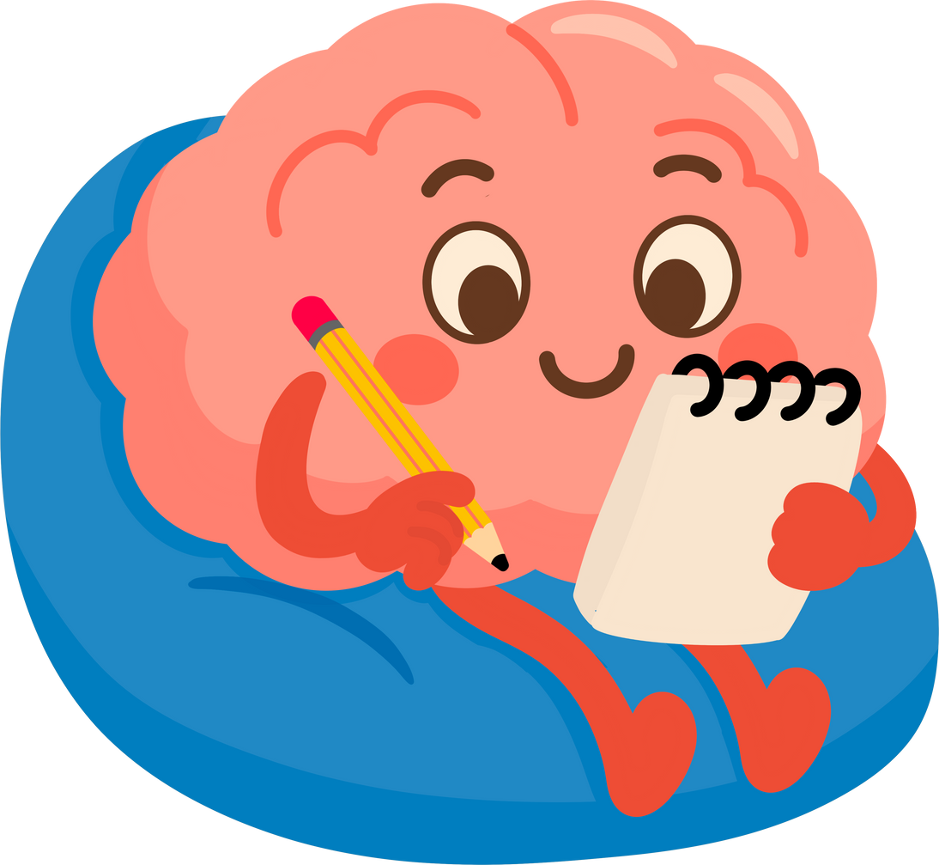
Autistic people cannot communicate
MYTH
Most Autistic people communicate verbally. Some may communicate in different ways, eg writing, using pictures, signing or whispering.
Notes:
Take suggestions for each questions… hands up if you think truth? Hands up if you think myth?

Slide 12
All ADHD people need medication
MYTH
While medication can help some people, there are also other things that can help such as lifestyle changes and support from family, friends and teachers.

Slide 13
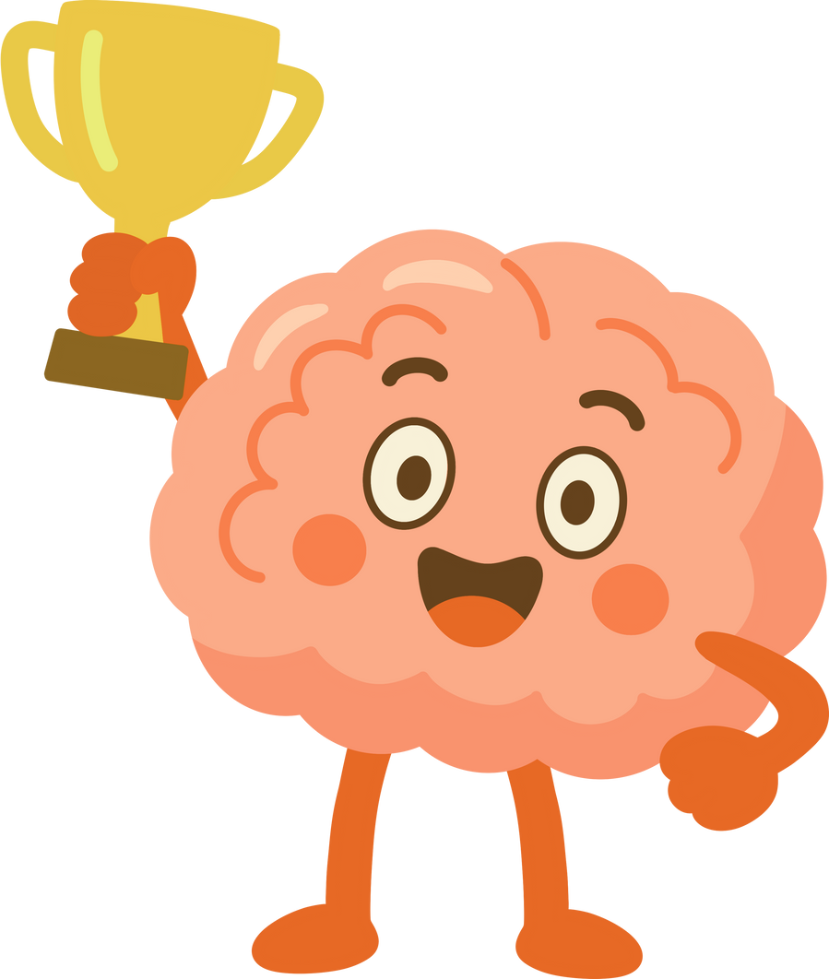
Many Autistic people have strengths in a certain subject.
TRUTH
Everyone, whether Autistic or not, has strengths and can be brilliant in specific areas.
Notes:
Take suggestions for each questions… hands up if you think truth? Hands up if you think myth?

Slide 14
Being ADHD means you are always hyperactive.
MYTH
Some people may be hyperactive. Others may appear quiet and withdrawn but may be experiencing hyperactivity in ways we can not see, like a really busy brain

Slide 15
Autistic and ADHD brains are rare
MYTH
100 years ago people thought Autism and ADHD were rare. We now know that there lots of Autistic and ADHD people in the world. We are still learning how common it really is.
Notes:
Take suggestions for each questions… hands up if you think truth? Hands up if you think myth?

Slide 16
What does this mean in school?

Slide 17
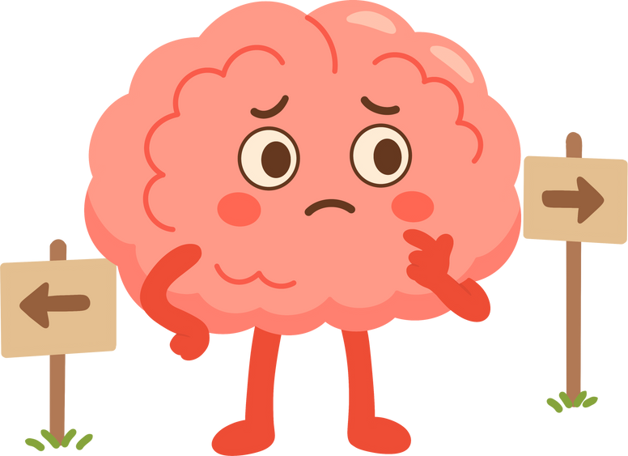
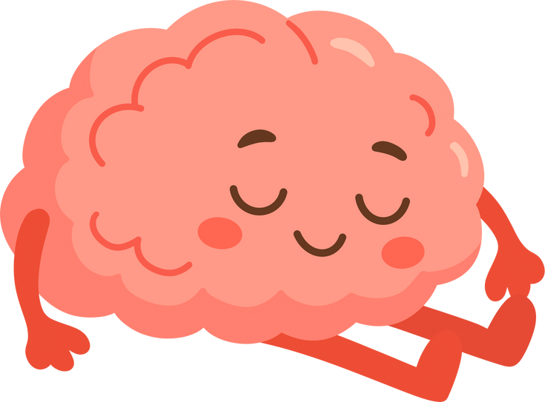
School can feel different
Support is Fair
Notes:
School can feel different for different brains
Some students find school quiet and calm - Others may find it loud, busy, or exhausting.
An autistic student might be working very hard just to manage noise or changes. A student who is ADHD might be working very hard just to stay focused or still.
Even if it looks easy from the outside - their brains may be working extra hard on the inside.
Some students use supports to help them learn and feel safe, such as: quiet spaces, headphones, movement breaks, fidget tools, extra time and clear, simple instructions.
These supports are not special treatment - They are fair.
Fairness does not mean that everyone gets the same - it means everyone gets what they need.

Slide 18
Poem
Notes:
The poem we are about to listen to was created by Autistic and ADHD children to help others understand what their brain is like.
It can sometimes be tricky having a brain that works differently but there are some amazing strengths that come with it too.
A lot of honesty and bravery went into this poem so have a listen and see what you think.

Slide 19
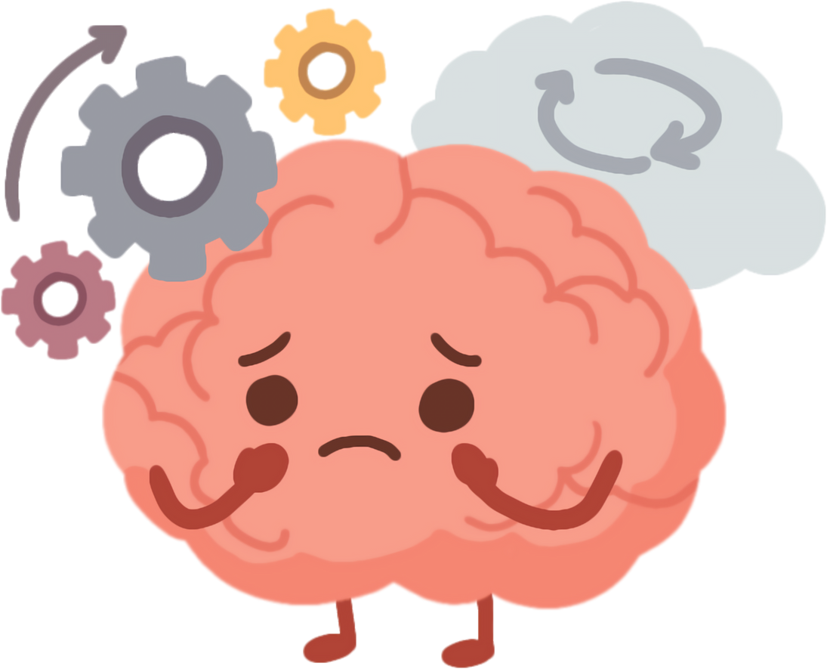
Masking
Some Autistic and ADHD people feel pressure to hide how their brain works.
Notes:
There may have been some words used in the poem you haven’t heard of before – like ‘Masking’
Some autistic and ADHD people feel pressure to hide how their brain works. This is called masking.
Masking can mean: forcing yourself to sit still when it feels uncomfortable, pretending noise or confusion doesn’t bother you or copying others so you don’t stand out as being different.
Masking takes a lot of energy and it can make people feel very tired or stressed.
In our school, we want people to feel safe enough to be themselves.

Slide 20
What can we all do?
Be patient
Be kind
Listen
Don’t judge
Notes:
So, What can we all do?
We can: be patient and kind, give people time and listen instead of judging.
Remember we don’t always see how hard someone is working.
Autistic and ADHD people often have amazing strengths like: creativity, honesty, determination, problem-solving and a deep focus on things they love.
Our school — and our world — needs lots of different types of brains.

Slide 21
Different belongs
Notes:
As we finish our assembly today I have one last thing to show you.
The poem that the children created has also been used to create a song called ‘Different Belongs’.
As you listen, remember: Someone else’s brain working differently is not a problem that needs fixing — it’s what makes us human and we need all these differences to make the world the incredible place it is.

Slide 22
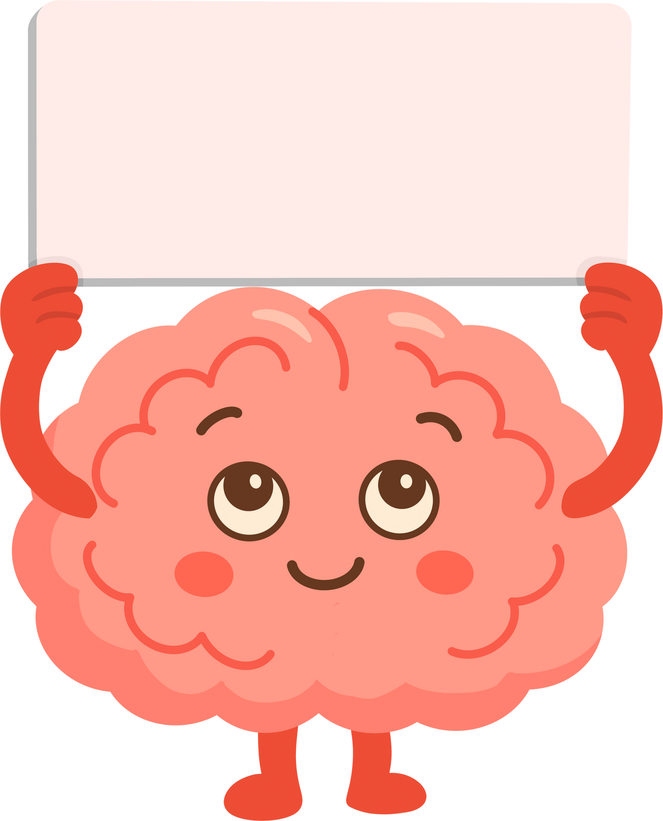
Thank you!!

