Slide 1




Children’s Artwork
Masking
©Add-vance (The ADHD and Autism Trust) & Nessie in Ed CIC
Notes:
Examples of artwork produced by Autistic and ADHD children to show what they feel like on the inside versus the outside

Slide 2
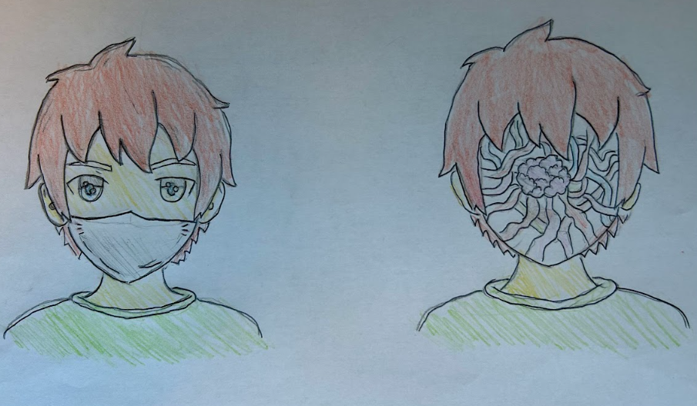

Slide 3
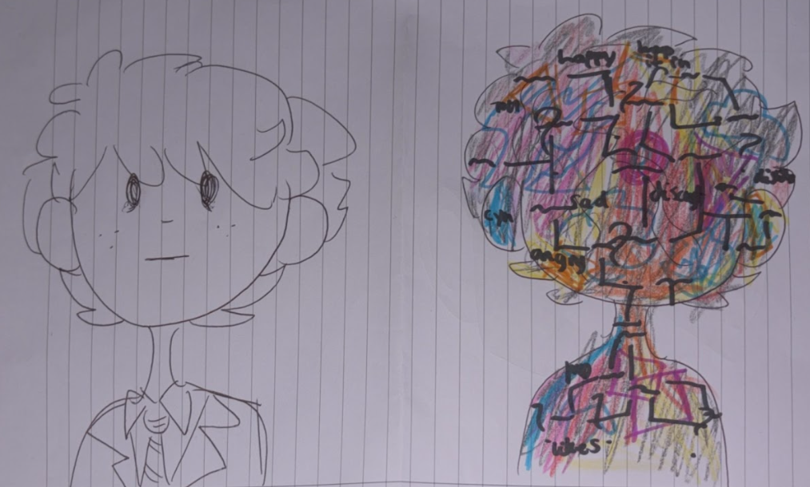

Slide 4
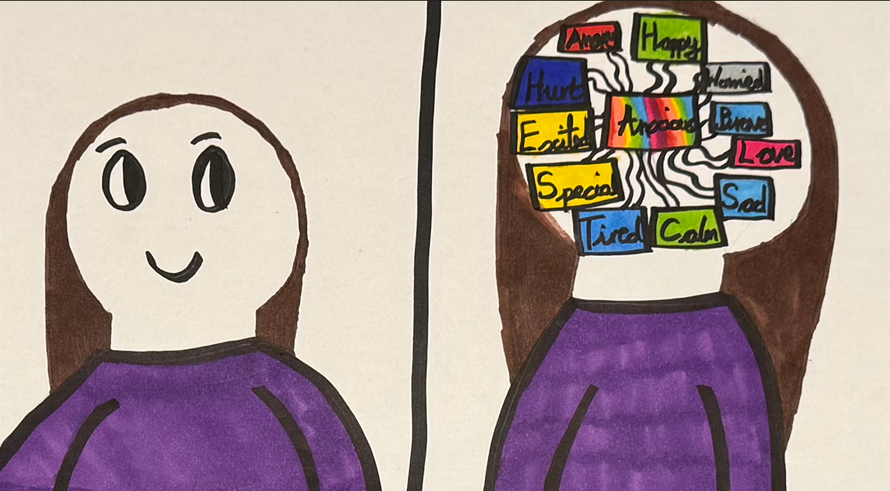

Slide 5
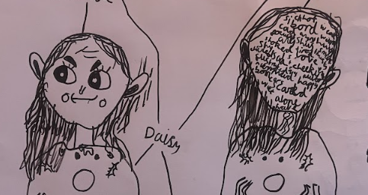

Slide 6
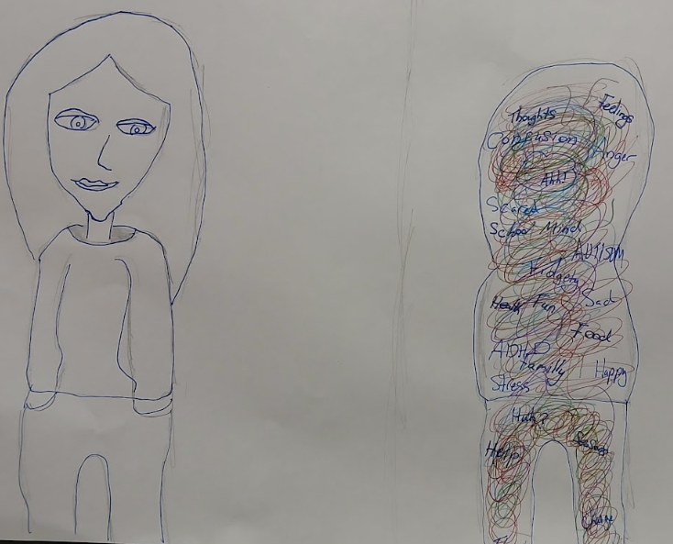

Slide 7
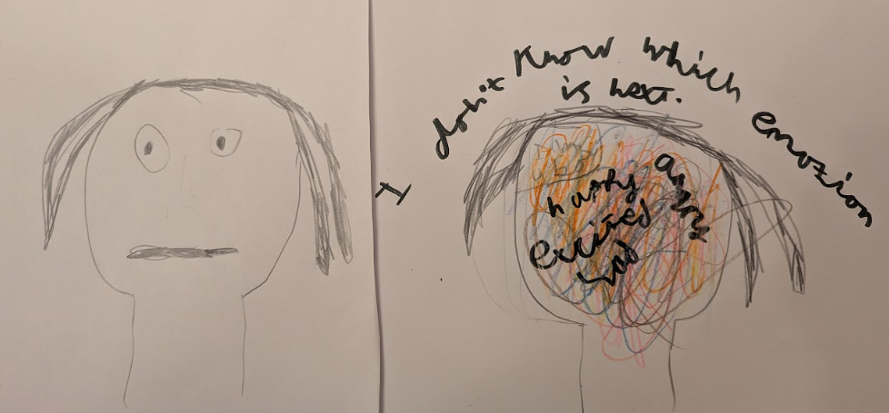

Slide 8
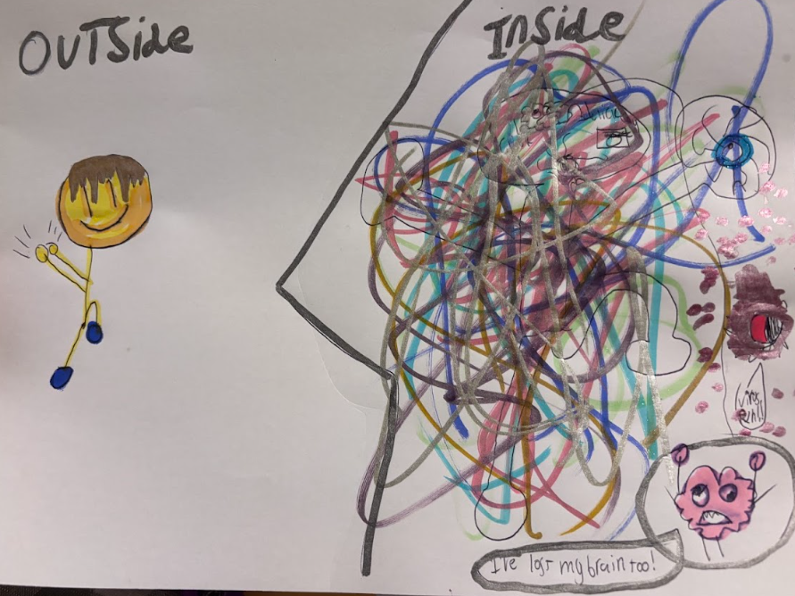

Slide 9
Children’s alternative representations
©Add-vance (The ADHD and Autism Trust) & Nessie in Ed CIC
Notes:
Some children interpreted the masking differently and produced a variety of forms of interpretation.

Slide 10
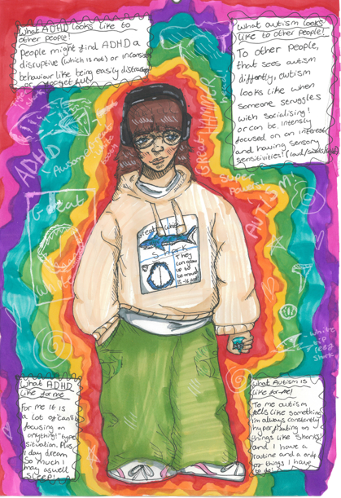

Slide 11
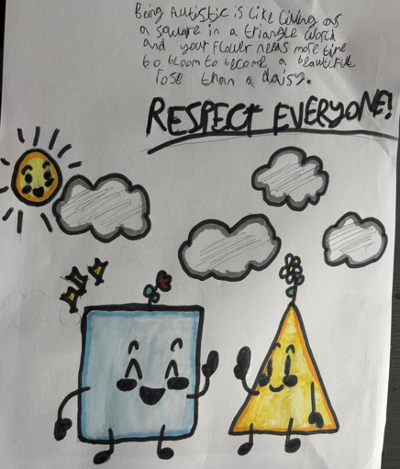

Slide 12
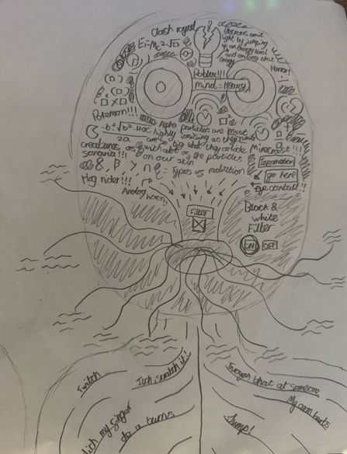

Slide 13
